Slide 1

Safeguarding: 2026-27 Update
Improving Life Chances through Education and Opportunity

Slide 2
Contents
Reminder: definition of safeguarding (slides 3-5)
What’s new (slides 7-9)
  Summary of updates to Keeping Children Safe in Education (slide 7)
  Context and local priorities for 2026-7 (slides 8-9)
What do Trustees & Governors need to do? (Slide 11)
ALT approach (slides 13-18)
  Clarity of purpose: our aims for safeguarding (slide 13)
  Clarity of role: delegation (slide 14)
  Collaboration: networks (slide 15-16)
  Challenge: delegation and data (slide 17)
  Continuous improvement (slide 18)
Reference and Advice (slides 19-22)
Improving Life Chances through Education and Opportunity

Slide 3
Safeguarding – a reminder…
Safeguarding and promoting the welfare of children is everyone’s responsibility. Everyone who comes into contact with children and their families has a role to play. In order to fulfil this responsibility effectively, all practitioners should make sure their approach is child centred. This means they should consider, at all times, what is in the best interest of the child (KCSIE)
If you believe a child is at risk or you have safeguarding concerns you MUST report these to your School’s Designated Lead (DSL), Headteacher or the Trust’s CEO
Out of hours/school holidays contact: Oxfordshire MASH:
0345 050 7666 or (out of office hours) 0800 833408
If you think a child is in immediate danger call the Police on 999
Improving Life Chances through Education and Opportunity
Notes:
Keeping Children Safe In Education (KCSIE) … the importance of everyone playing a part
All Trustees and Governors must read part 2 (leadership) as a minimum.

Slide 4
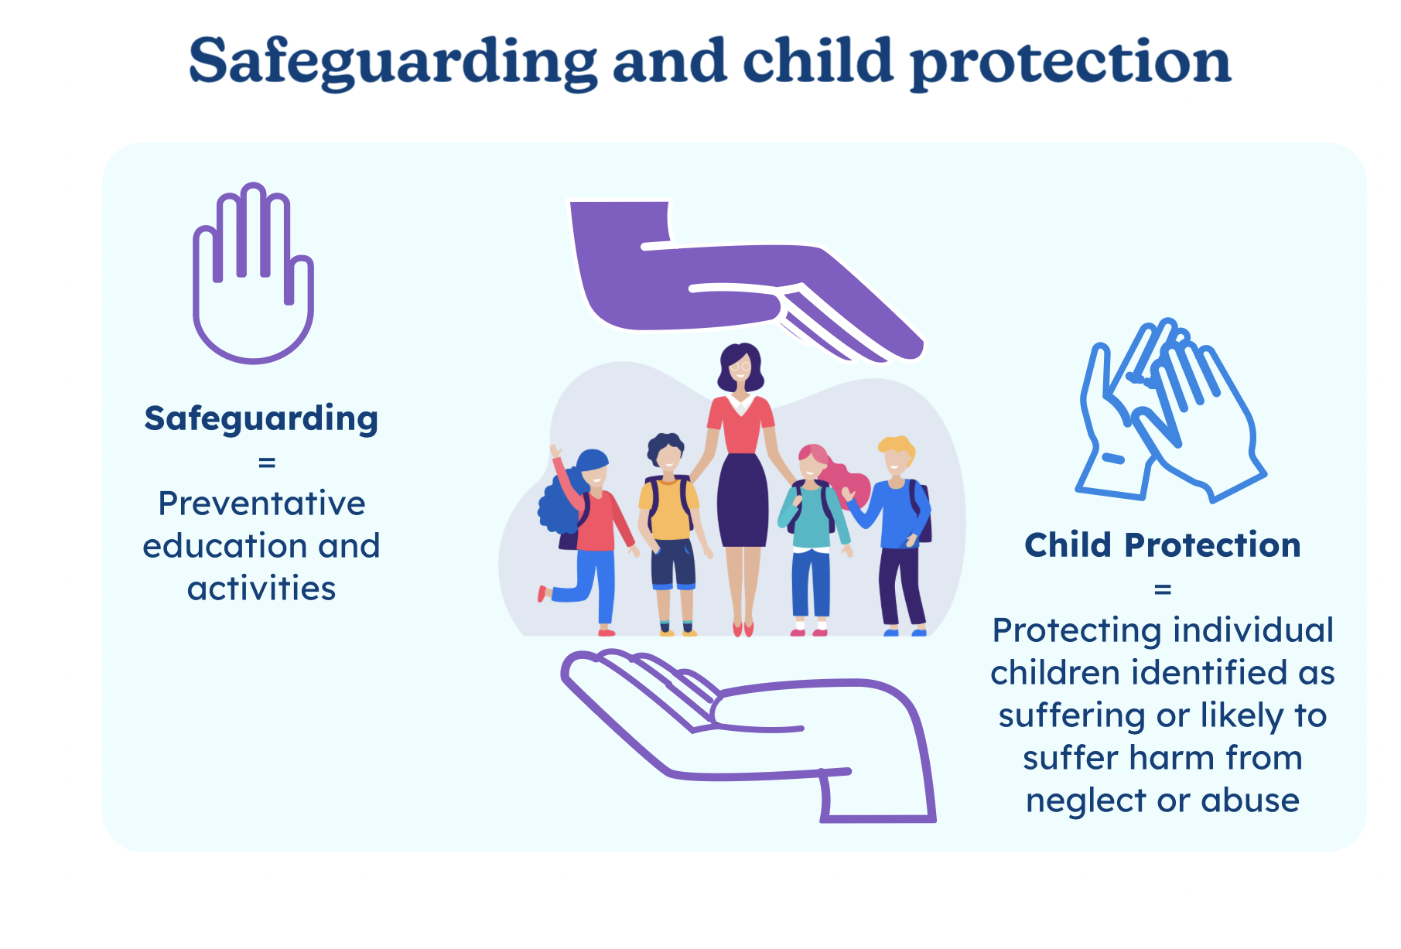
Training - NGA: Safeguarding – How to fulfil the governance role (e-learning)
Thriving now and in the future
Notes:
More than child protection…
Child protection is part of safeguarding – a term used for the most serious safeguarding situations, where professionals, such as social workers or the police, have to act to protect a child (Ofsted)
Safeguarding is pro-active, preventative
Child protection is reactive, responding to harms
All governors must complete elearning - NGA learning link ‘Essential Safeguarding’ annually to keep up to date

Slide 5
What is safeguarding?
Safeguarding
Child Protection
Cybersecurity
GDPR
Behaviour Management
Attendance
Online safety
School transport
Health & Safety
Managing allegations
Low level concerns
Staff code of conduct
Recruitment & selection
Anti-bullying
Work experience
Educational visits
Building design
Lettings
Whistleblowing
Outcomes
Training
Alternative Providers
Curriculum inc PSHE
Children Missing Education
Improving Life Chances through Education and Opportunity
Notes:
Safeguarding (safety, wellbeing, positive outcomes) is integral to the operation of our schools – linking to many elements of school / organisational performance (everyone’s responsibility)

Slide 6
What’s New?
Improving Life Chances through Education and Opportunity

Slide 7
What’s new: KCSIE 2026… summary of changes
Key points: (See KCSIE Annex D for full list of changes)
Gender Questioning Students: (paras 104-115; 191-196;245-275)
  Must provide single-sex toilets, changing/showers, and accommodation (based on biological sex). Should consider alternatives if requested; keep clear records; Social transitioning – schools should not initiate; Involve parents – prioritise child’s best interests and risks
Mobile phones (para 163): phone free schools statutory from 29 June 26
AI & Online risks: (references throughout )
  Deepfakes, AI-generated abuse; sextortion; grooming via chatbots. Review policies, staff awareness, filtering&monitoring systems
DSL cover (para 126): robust cover and continuity expectations
Recruitment checks (para 292) online checks clarified as search engine-based
Sexual Harassment (Annex 5): stronger language on expectations for separating pupils and requirement for risk and needs assessments
Improving Life Chances through Education and Opportunity
Notes:
Some significant updates for 2026
- 78 new paragraphs including new responsibilities, clarifications and guidance – 4 page summary of changes!

Slide 8

What’s new: Local Priorities …
Neglect
Child Exploitation, including County Lines
Adaptive teaching focussed on vulnerable learners
Attendance: with a focus on pupils eligible for FSM and on SEN register
SEMH and safeguarding provision beyond the classroom
Improving Life Chances through Education and Opportunity
Notes:
Current local and Trust priorities

Slide 9
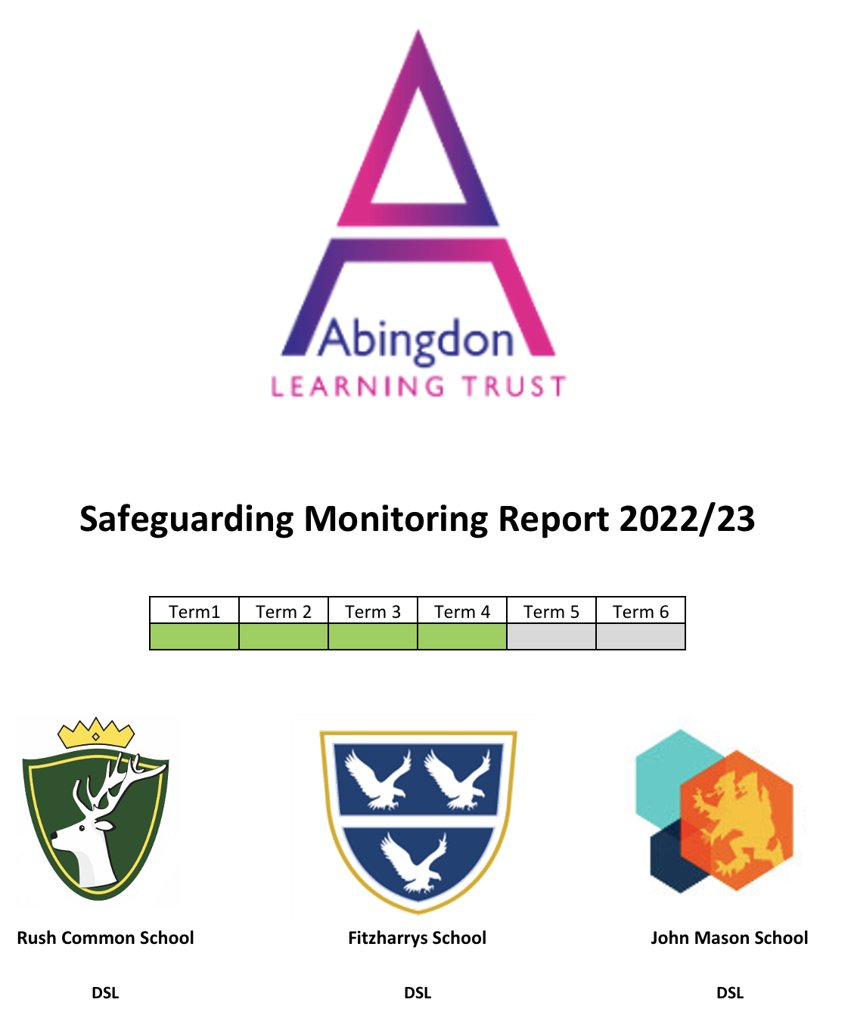

What’s New: School priorities and trends
What is the DSL’s view?
What are the data telling you?
St Michael’s CE School
Improving Life Chances through Education and Opportunity
Notes:
For LACs – what priorities are your headteacher and DSL identifying and what plans are in place to address these?

Slide 10
What do Trustees and Governors need to do?
Improving Life Chances through Education and Opportunity

Slide 11
2026 Trustee and Governor Actions
Statutory annual policy review:
Ensure your school’s policy uses the agreed Trust /OCC template and has been appropriately customised
Ensure the new policy is available on the school’s website
Support and Challenge school leaders – questions to consider
Complete and record completion of annual training
Read KCSIE (Part 2), School Safeguarding Policy, Trust guidance
E-learning: Essential Safeguarding (NGA), Prevent Duty (HM Gov), Cyber Security (NCSC)
What steps is the school taking to implement the KCSIE updates?
How are DSLs/Safeguarding teams being supported to manage growing responsibilities?
How will the school ensure its systems and processes remain compliant and effective?
Have all staff completed training, including covering the changes? How does the school know this training is effective?
Notes:
Policy will be updated (using the OCC model) centrally for all schools to adopt
Complete required annual training
Read KCSIE (minimum part 2 noting changes in Annex D)
Read school policy and Trust guidance
Essential Safeguarding (e-learning NGA learning link)
Prevent Duty (HMGovt)
Cybersecurity (NCSC)

Slide 12
Our Approach
Clarity
Collaboration
Challenge
Continuous Improvement
Improving Life Chances through Education and Opportunity
Notes:
The Trust aims to –
- Be clear on aims, what we are doing and our role
- Work together
- Provide challenge for robust accountability and assurance
- Continuous improvement (including meeting new statutory and contextual requirements)

Slide 13
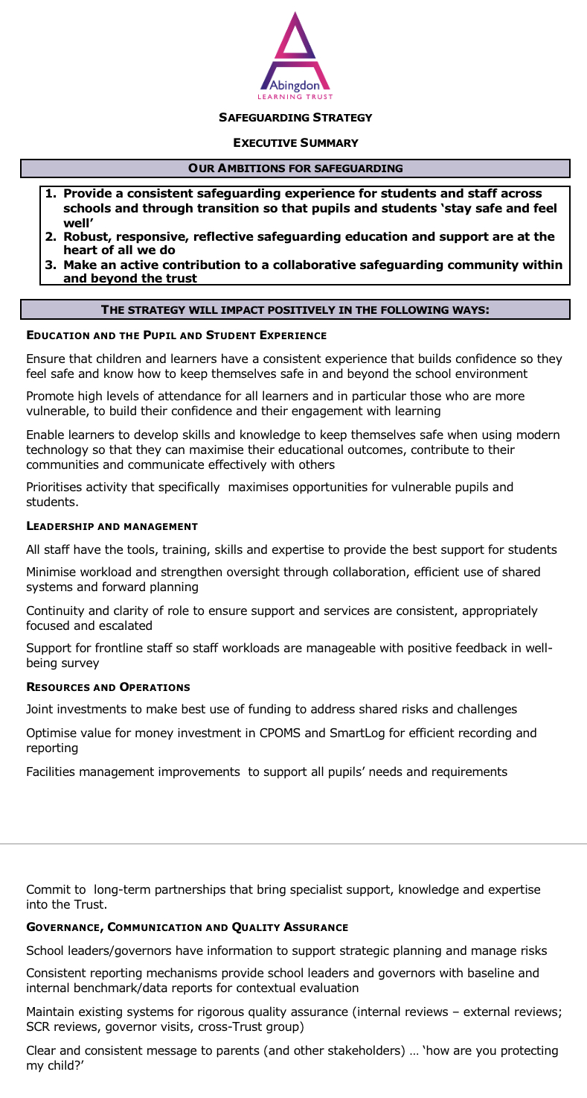
Our aims for safeguarding
Clarity of purpose
Provide a consistent safeguarding experience for students and staff across schools and through transition so that pupils and students ‘stay safe and feel well’
Robust, responsive, reflective safeguarding education and support are at the heart of all we do
Make an active contribution to a collaborative safeguarding community within and beyond the trust
Improving Life Chances through Education and Opportunity
Notes:
Strategy discussions with the DSLs set out some core goals for safeguarding for our Trust
We want all pupils to feel and be safe and well… and know how to keep themselves safe and well
We want to be robust, responsive and reflective in all our safeguarding work so support and interventions are targeted to support the vulnerable and make a difference (assessed for impact)
We want to work together within the Trust and beyond, looking to our local community and the wider community and educational family too

Slide 14
Trust Board (TB) - Local Academy Committee (LAC)
Clarity of role
Governing bodies and proprietors have a strategic responsibility for their school’s or college’s safeguarding arrangements and must ensure that they comply with their duties under legislation. (KCSIE)
Governing bodies and proprietors have a strategic responsibility for their school’s or college’s safeguarding arrangements and must ensure that they comply with their duties under legislation. (KCSIE)
Policy – Ethos – Targets - Oversight (accountability, assurance, engagement)
Appointing a safeguarding trustee/governor
Ensure governors receive appropriate training
Policies and procedures inc risk management
Appointing a designated safeguarding lead/teacher for children we care for
TB support and reviews
LAC responsibility
TB/LAC decision
TB policy, system + LAC oversight
Single Central Register (SCR)
LAC oversight
Hold Executive to Account for compliance, standards and progress of plans
TB policy, system, reviews
LAC oversight
Ensure staff receive appropriate training
TB reviews
LAC oversight
Ensure pupils are taught about safeguarding
TB reviews
LAC oversight
TB for CEO
LAC for HT + TB reviews
Improving Life Chances through Education and Opportunity
Notes:
The Trust board as the accountable body will seek assurance through the CEO that
Statutory responsibilities are being met
Risks are being identified and mitigated
Mitigation plans (improvement plans) at Trust and School level are effective
Through the Executive the Trust Board requests reviews (assurance framework) and develops/implements shared systems for efficiency and support. These reviews help the LACs in their oversight role too.
Through the scheme of delegation the Trust board allocates responsibility for the oversight of safeguarding to ensure local provision meets the needs of students in each school.
Key Local Academy Committee (LAC) roles are to
ensure statutory requirements are met by their school
understand local needs and priorities and
ensure policies, procedures and plans are working
This includes considering what training governors need.
Beyond these core requirements think about what information you need to understand how effective policies and plans are.

Slide 15
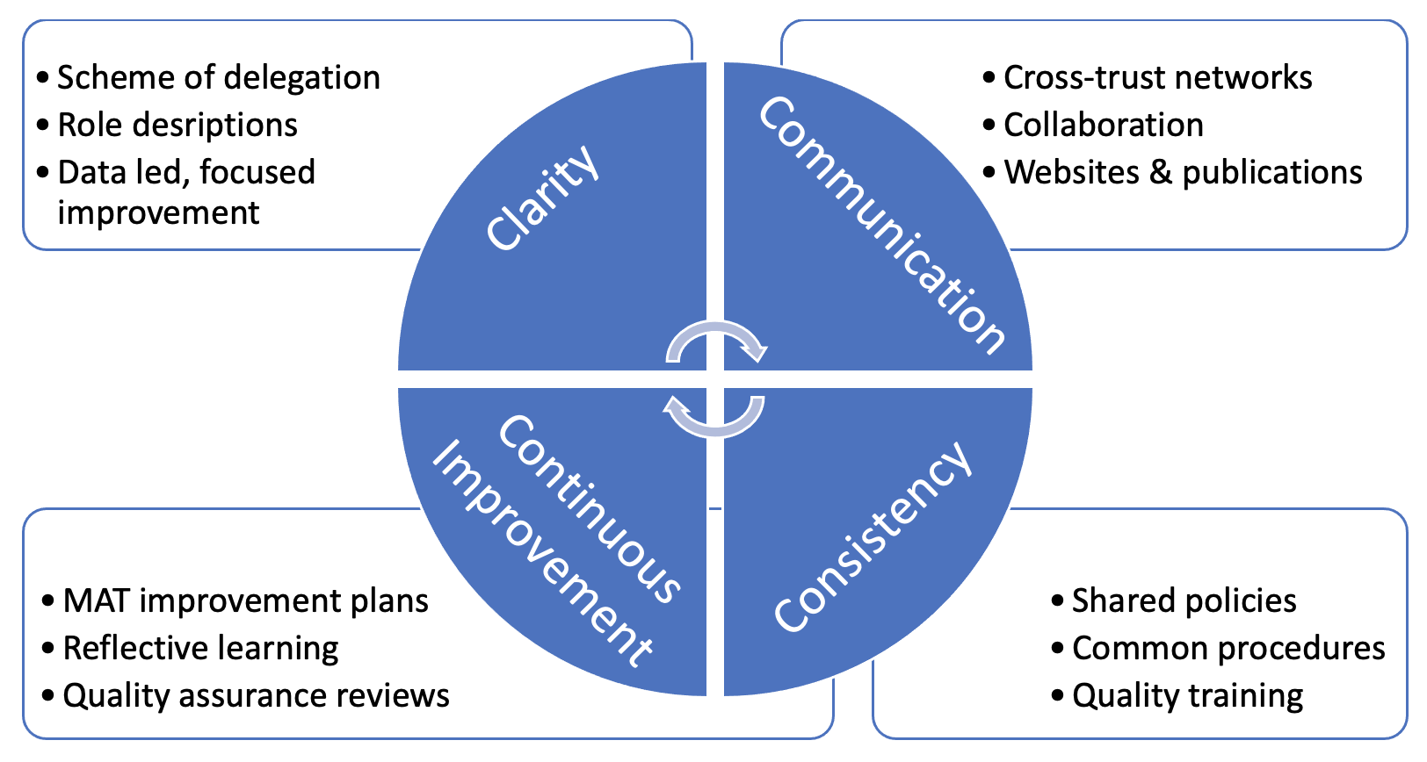
Collaboration
Safeguarding Network
Improving Life Chances through Education and Opportunity
Notes:
As a MAT we are able to work together in the networks for a stronger safeguarding community:
Brings Clarity – what do we need to do, what is the priority, who is doing what?
Supports Cross-trust communication – sharing expectations, resources, information, knowledge and experience of what works well (or not)
Seeks Consistency – not just for compliance and efficiency, although it helps there, but so that by working in similar ways, using similar systems we can support each other, offer advice and, where necessary, provide cover for continuity. Finally,
Drives Continuous improvement – providing time and analysis to consider whether actions are working, or not, considering how to tackle new challenges and working on approaches designed to make things better.
Our Trust partnerships, through these networks, bring both assurance and reassurance and feed into and support the work that we all oversee.
The partnerships help to address the challenges posed while also keeping our aim high but they only work with pro-active engagement and collaboration from staff and all those in governance – a big thanks to all involved!

Slide 16
Trust Board: approve trust-wide Safeguarding and Child Protection policy; delegations
Headteacher: Implement policy; Appoint & performance manage DSL
DSL
Implement KCSIE
Trust Educational Standards Committee: oversight
Local Academy Committee: adopt and monitor school policy and plans
Trust-wide Safeguarding Group (operational) and Network (governance) peer reviews, joint work and reflection
CEO :Challenges & Supports; Quality Assures implementation
ALT Trust: Safeguarding Map
Collaboration & Challenge
Trust Board: Accountable body
Approve Policies
Ensure risks are identified and mitigated
With CEO
Assurance for compliance & impact
Local Academy Committees: Responsible body
Adopt Policies
Monitor implementation e.g. visits, reports
With headteacher
Assess local context, risks and priorities
Agree and monitor local action plans
Our approach to safeguarding offers an example of how the Trust model brings benefits – combining local knowledge for context and rigorous oversight with Trust co-ordination for efficiency and resilience.
Stronger Together
Notes:
Organisational structures reflect the importance we place on safeguarding and provide rigorous oversight

Slide 17
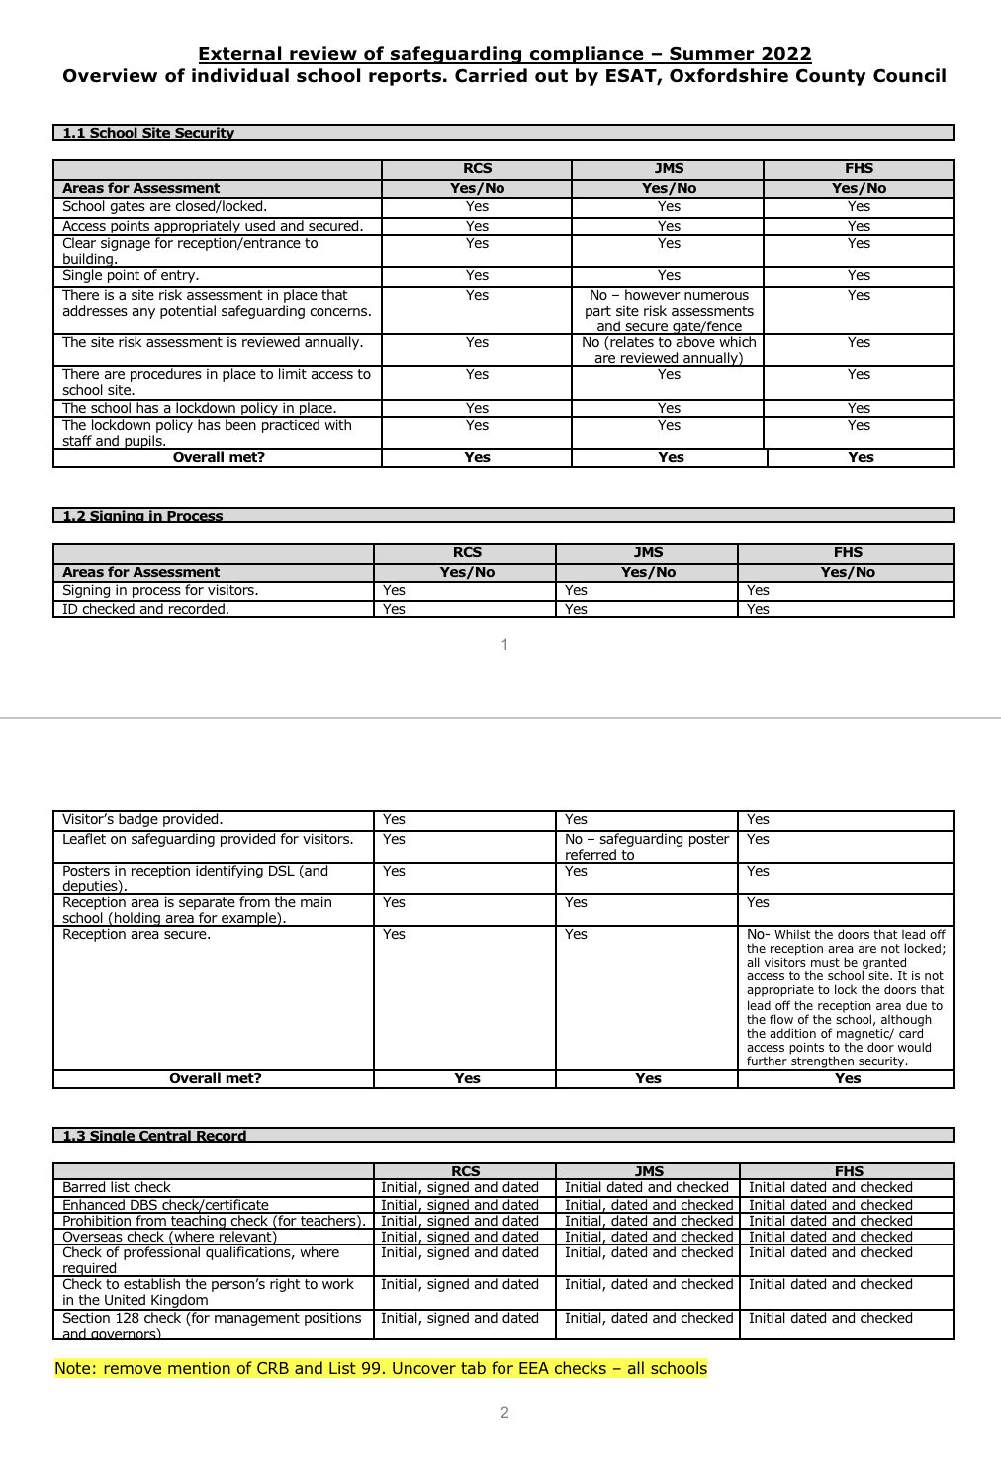
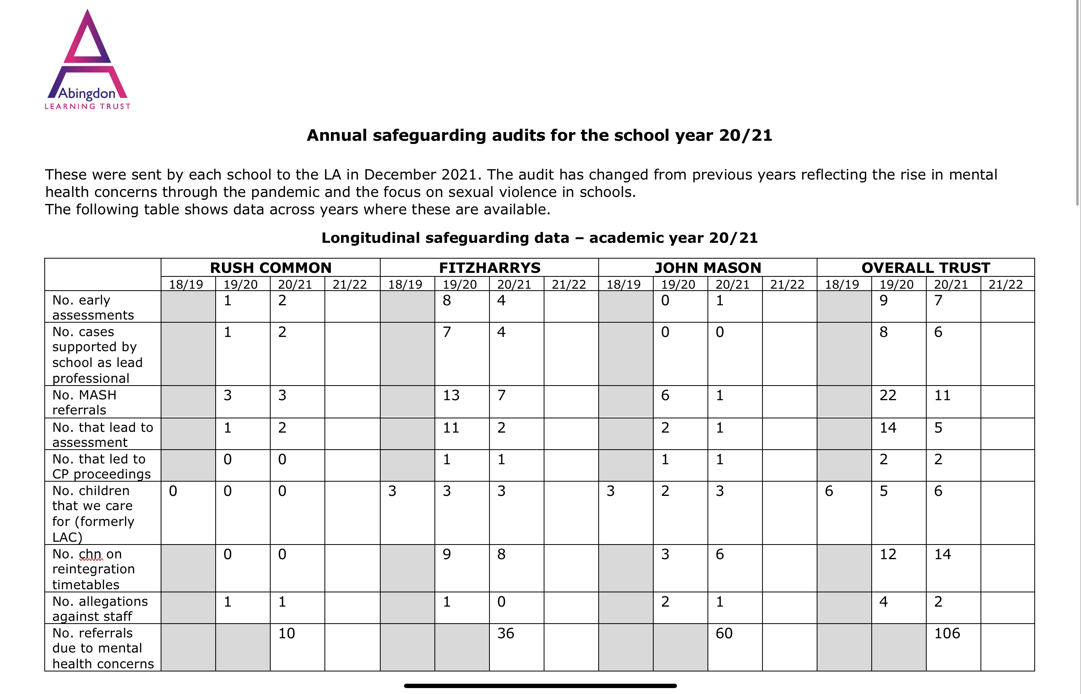


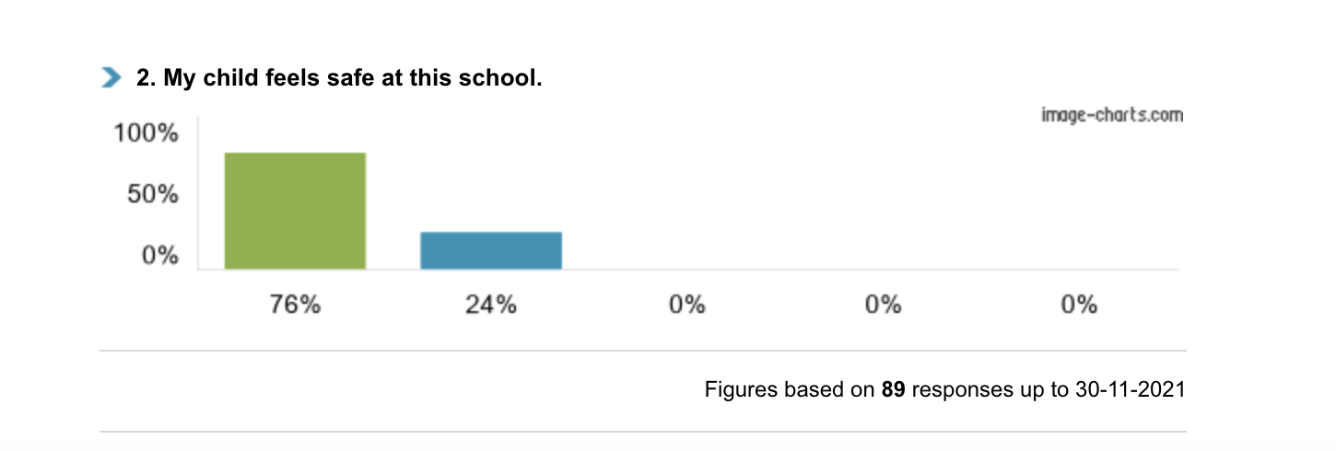
Data: target - impact - improve
Challenge
Annual reviews: Internal via Trust with an External review every 3 years
School – School comparisons, summary of action points (School & Trust)
2. Annual report to OCC: For each school and summarized across the Trust: School-School / Year-Year comparisons , trends and action points (School & Trust)
3. Reports to Educational Standards, Safeguarding Network & LAC meetings
Executive/Headteacher report: significant incidents, risks, progress of plans (data and narrative)
Trustee/Governor report/ visits
Trust/School Risk Register
4. Ofsted reports: strengths and areas for improvement
5. Pupil & Parent Views: stakeholder feedback
Improving Life Chances through Education and Opportunity
Notes:
Lots of information available to help target intervention and assess effectiveness (assurance) and impact
Executive arrange
Annual SCR review (Autumn)
Annual internal safeguarding reviews (Spring)
Ad hoc reviews on topics of focus
External reviews on a 3 year cycle or in response to specific issues
Compliance, trend and risk reports should be provided termly by DSL and presented to the LAC regularly
Regular LAC safeguarding governor visits add to this framework
Stakeholder feedback is also a vital information source – e.g. surveys, student voice, complaints
Key point is to use multiple sources to cross-check for verification (triangulation)
Celebrate achievements
Identify priorities
Check progress
Example questions available in the Local Academy Handbook and NGA website

Slide 18
Continuous Improvement
Statutory Change
Local Priorities
School Priorities
Annual updates to KCSIE
Legislative updates to other areas
DfE guidance
Oxford Safeguarding Children Partnership
ALT Trust Safeguarding Action Plan
ALT Trust Strategy
– Alignment and Consistency
Collaboration and Ambition
Impact and Relationships
Improved Life Chances
School Self-Evaluations
School Improvement Plans
Data trends
Stakeholder feedback
ALT Trust / External Quality Assurance
Regular Review and Update
Improving Life Chances through Education and Opportunity
Notes:
Vigilance and constant review mean that safeguarding is always developing
Change is driven by statutory requirements and, particularly by context – what are the local priorities, the needs of the children in your school?

Slide 19
Reference slides and further advice
Improving Life Chances through Education and Opportunity

Slide 20
Local Priorities: ALT Trust Safeguarding Priorities
(2026-2027)
Adaptive teaching focussed on vulnerable learners
Attendance: with a focus on pupils eligible for FSM and on SEN register
SEMH and safeguarding provision beyond the classroom
Improving Life Chances through Education and Opportunity
Notes:
School feedback and data leads to a shared action plan
Risks arise particularly around attendance and behaviour and link to a rise of mental health concerns.
Where pupils’ needs are met more effectively in the classroom, they will attend more and achieve better outcomes – keeping them safe whilst in school, and ‘protecting’ them beyond school as better outcomes mean more choice of education training and employment.
For attendance – absence may also be an indicator of safeguarding concerns
SEMH and SG provision beyond the classroom links to ensuring that the intervention is suitable for a pupil and has positive impact for them…..too often in the past it has been ‘out of sight, out of mind’ and that’s when safeguarding issues can arise.
If not in school (absence or suspension) children may be at increased risk
In governance groups …
-What information do you need to help you understand your school’s context
-What information do you need to help you see whether plans/actions are working (making a difference)
-When/how frequently is this information needed
(See data reports as a starting point)
Safeguarding should be on your agenda with regular reviews of attendance, behaviour (suspensions) as well as attainment – considering vulnerable groups, alternative provision and stakeholder feedback
- Has your school identified vulnerable pupils?

Slide 21
Training and Advice
All trustees & governors must annually
  Read Keeping Children Safe in Education (KCSIE) part 2
  Complete NGA ‘Essential Safeguarding’ learning link module
  Complete Prevent Awareness training
  Complete NCSC Cybersecurity training
  Read the Trust/School Child Protect & Safeguarding Policy
  Read the Trust’s Induction Leaflet and this presentation
These actions must be recorded on each Governor’s Governor Hub Profile
Further help and adviceAbingdon Learning Trust resources
  Trust website: https://abingdonlearningtrust.org/
  Governor Hub including example questions (NGA and School Data reports)
  CEO (ceo@abingdonlearningtrust.org) and safeguarding trustee (lfathers@abingdonlearningtrust.org)
Improving Life Chances through Education and Opportunity

Slide 22
KCSIE responsibilities (extract) | Trust Board | Local Academy Committee
Appropriate policies and procedures in place in order for appropriate action to be taken in a timely manner to safeguard and promote children’s welfare | Strategy & Ethos Set Trust vision, approve policies, agree targets Resource and delegation Appoint senior executive (Accounting Officer) with safeguarding lead role Include safeguarding functions in Scheme of Delegation and role descriptions Develop and manage central contracts (inc H&S, IT) Scrutiny & Risk Management Appoint SG Trustee/Educational Standards to: With CEO monitor compliance (e.g. internal checks, annual reports, audits, external reviews) Alert Board to risks (ALL committees) Recruitment Policy & Procedure (Central Team SCR) Trustees & governors – checks, SCR and training Trust approach (annual review - website) Promote good practice & consistency Promote DSL team working Post incident reflection & learning Progress Trust action plans | Approve local policy Ensure Headteacher has appointed DSL and Lead for CWCF SG governor appointment Monitor compliance with KCSIE inc Policy adoption, publication and implementation Recruitment & SCR Staff training Governor training (skills audit) Curriculum Provision (inc AP) meeting needs Cybersecurity / Online safety Multi-agency working Appropriate information sharing Annual report approval and action plan monitoring Report to Board (via Annual Report; via DSL) Support the development and monitor the progress of improvement plans
Appoint designated safeguarding lead (DSL) Support Multi-agency working Staff training (inc information sharing) Online safety & teaching
Safer recruitment Pre-apt checks (inc online) Interviews & references Single Central Register (SCR)
Procedures for managing allegations and concerns Consideration of cybersecurity standards and online safety Trustee/Governor training
Notes:
Summary responsibilities (refer to KCSIE)

